Slide 1
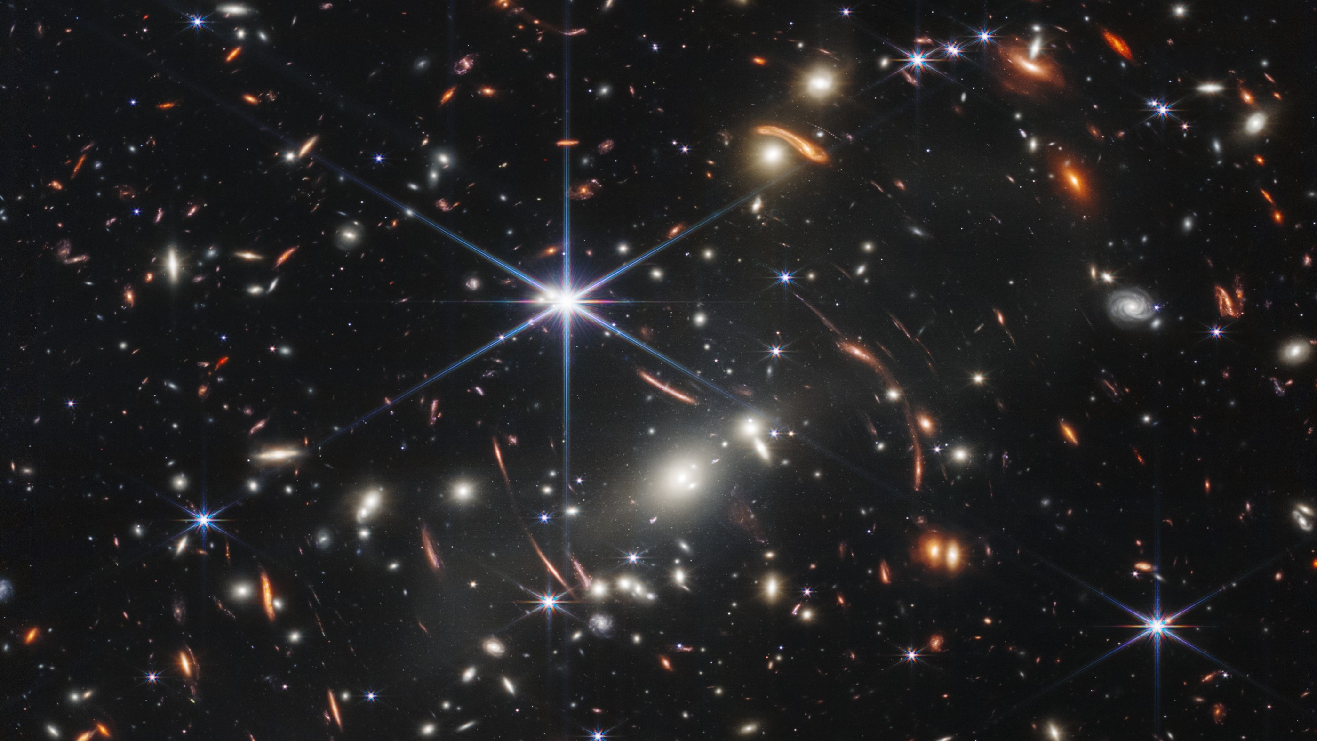




SKYSURF-IR: Assessing JADES completeness
Logan Conrad NASA Space Grant Windhorst's Cosmology Group + Darby Kramer
Mentor: Rogier Windhorst

Slide 2
Counting Galaxies with Confusion
Underpredicted Sky Measurements
Missing Faint High Redshift Galaxies
Confusion Limit
Assessing Completeness
Sky-SB (Sky Surface Brightness)
Notes:
2 Minutes

Slide 3
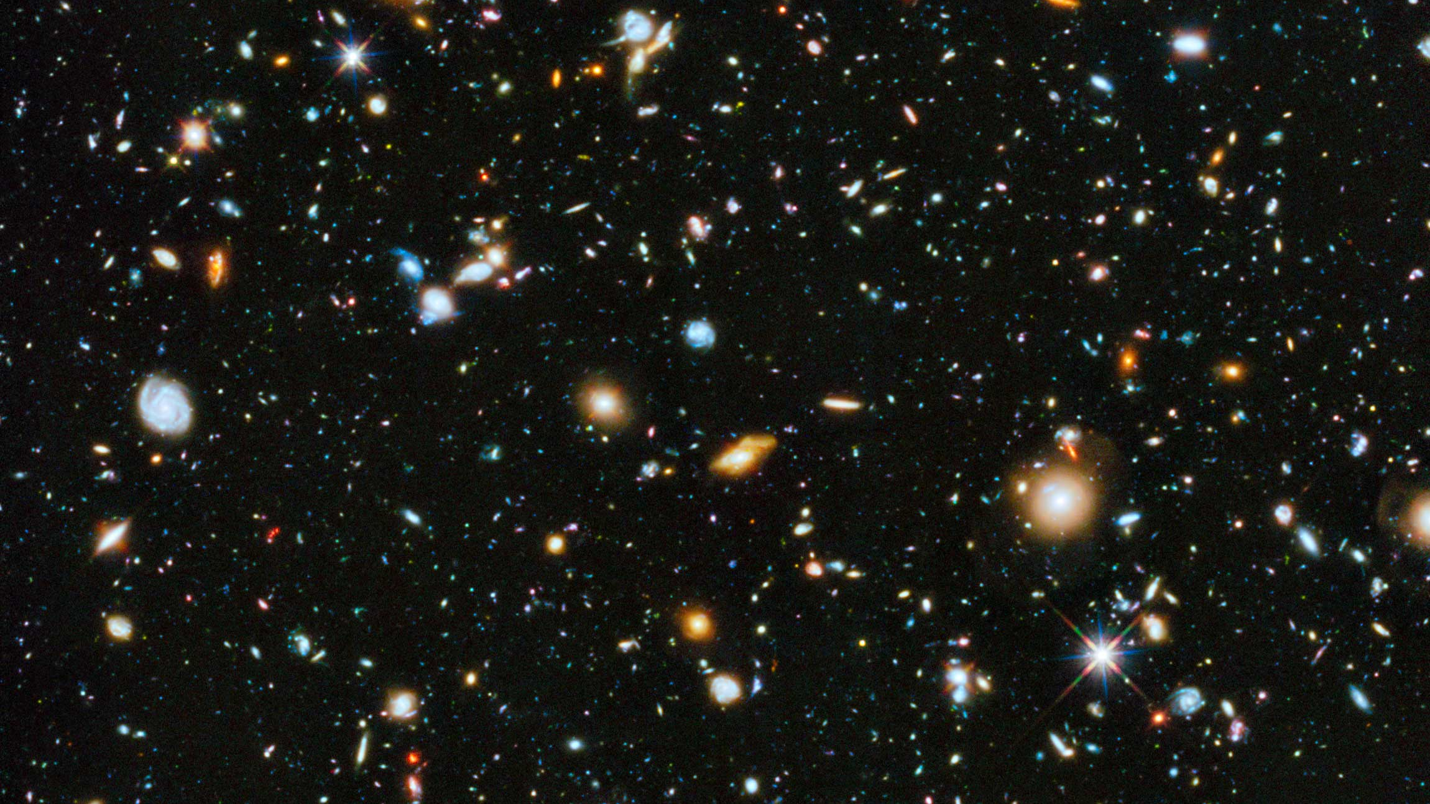

Slide 4


Slide 5
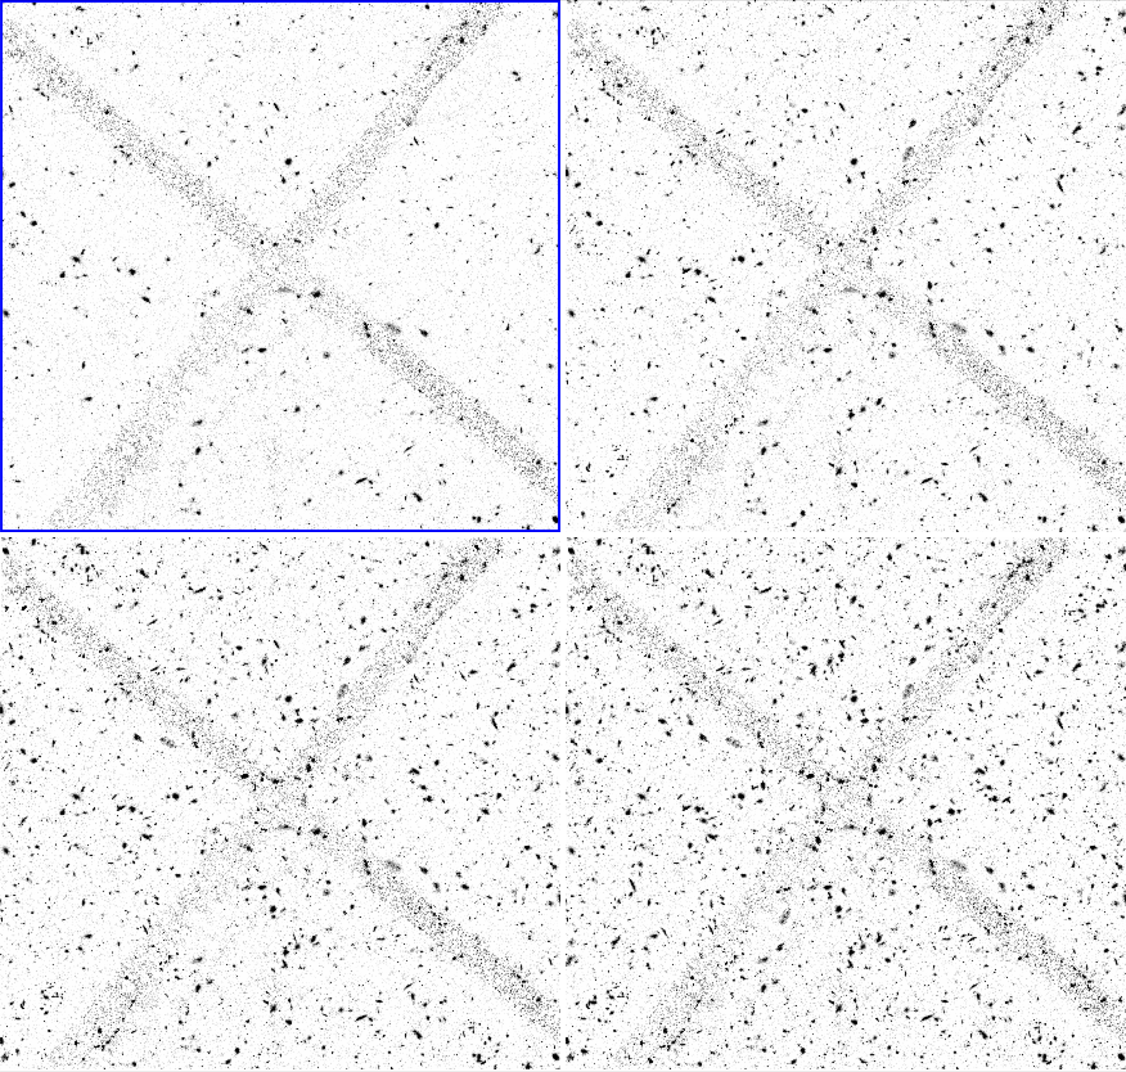

Slide 6
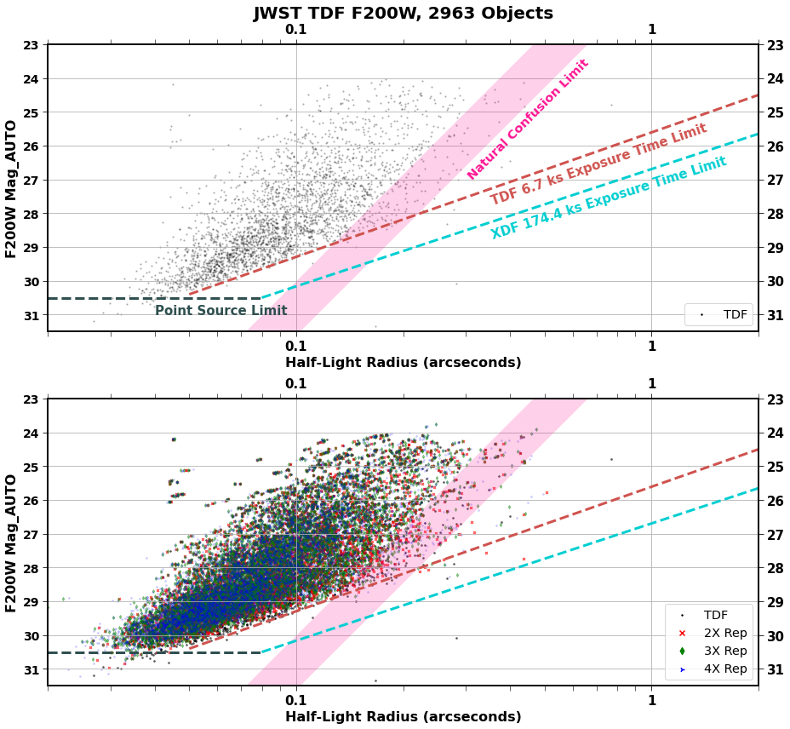

Slide 8
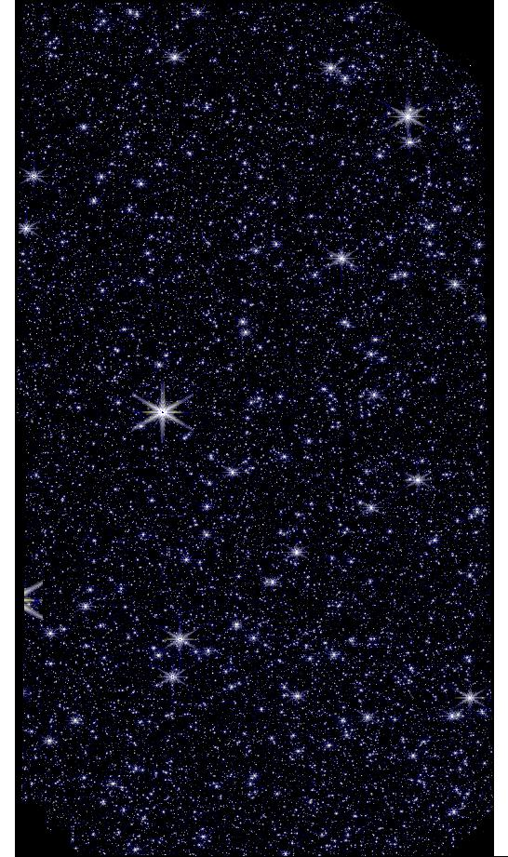
Simulations
MIRAGE
Why Simulations?
Density + Detail + Accuracy
Skip Rotation + Addition

Slide 9
Thank You
For more information: skysurf.asu.edu Acknowledgements: NASA Space Grant, Prof. Dr. Windhorst, Ms. Darby Kramer, SKYSURF and SKYSURF-IR teams

